Slide 1



Capture The Flag
Reverse Engineering
Not just executables

Slide 2
Reverse Engineering
What to do
Tools u might need
Demo
Discussion points

Slide 3



Reverse Engineering
Software Development
Reverse Engineering
Creating software by writing the code
In order to fulfil requirements
Done by software developer
Trying to get the code from existing software
In order to understand how existing program works
Done by outsider, usually not the authorized one

Slide 4


RE Steps
STEP 1
STEP 2
STEP 3
Understand the target format
Try to decompile
RTFC
You can use Ghidra, dnSpy, jadx, etc
READ the f*in CODE
file [path]

Slide 5





JavaScript
Web Browsers

Slide 6

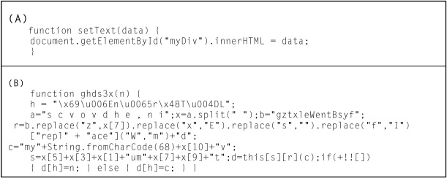

Obfuscation
Code obfuscation is the process of making applications difficult or impossible to decompile or disassemble, and the retrieved application code more difficult for humans to parse.

Slide 7
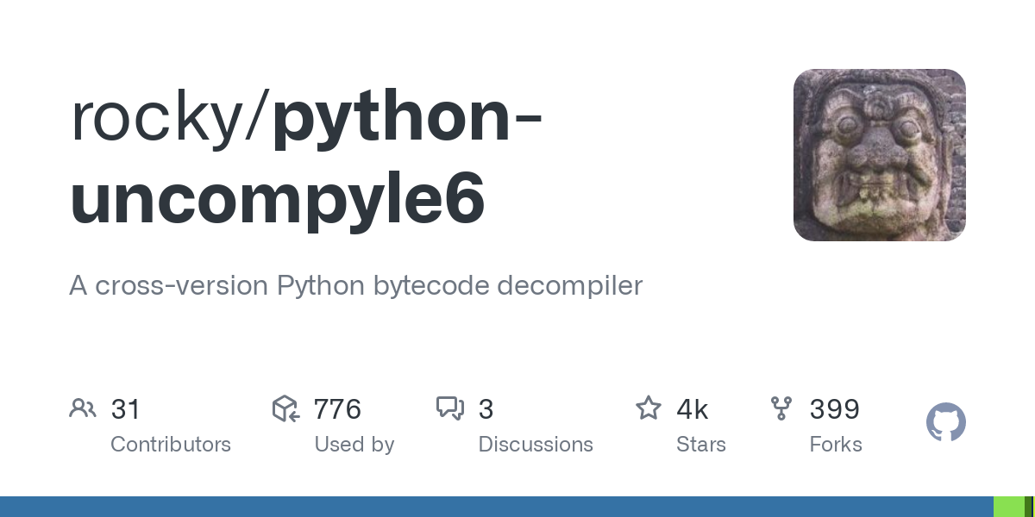
Python
https://www.toolnb.com/tools-lang-en/pyc.html

Slide 8


Java

Slide 9

.NET

Slide 10

Thank You

